Slide 1
Consistent Inference for Dialogue Relation Extraction
https://github.com/xinwei96/CoIndialogRE
IJCAI-2021
Reported by Dongdong Hu

Slide 2
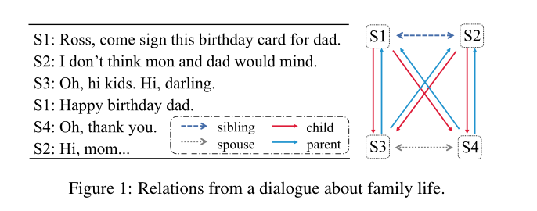
Introduction
Utterance Discrepancy
Topic Structure Discrepancy.
Relation Discrepancy.

Slide 3
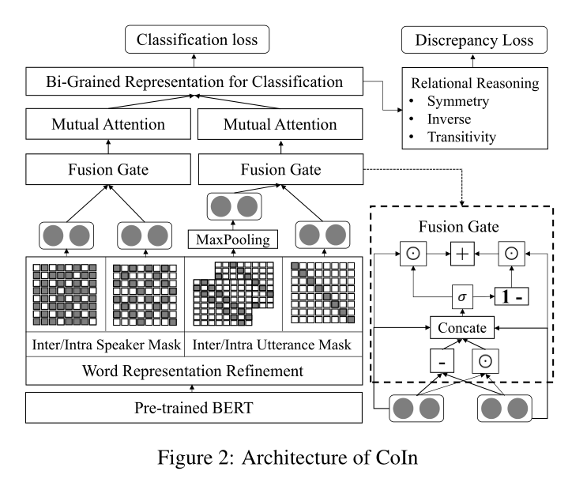
Method

Slide 4
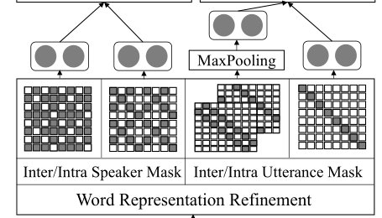
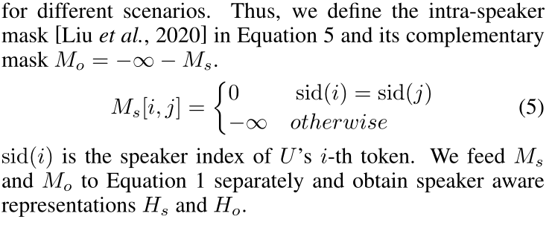
Method

Slide 5
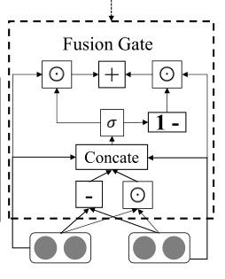
Method

Slide 6
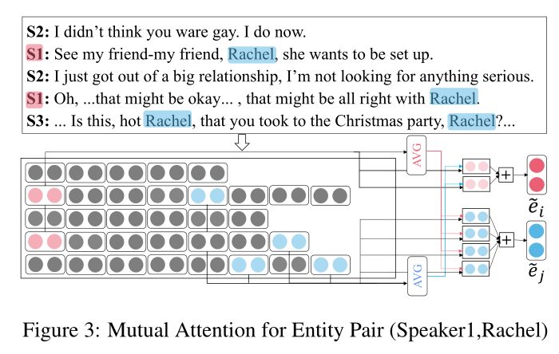
Method
Notes:
feed forward neural network layer (FFNN)
multi-class是相对于binary二分类来说的，意思是需要分类的东西不止有两个类别
multi-label是说一个sample的标签不知有一个。

Slide 7
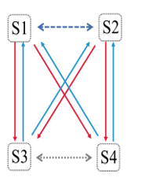
Method
Notes:
feed forward neural network layer (FFNN)
multi-class是相对于binary二分类来说的，意思是需要分类的东西不止有两个类别
multi-label是说一个sample的标签不知有一个。

Slide 8
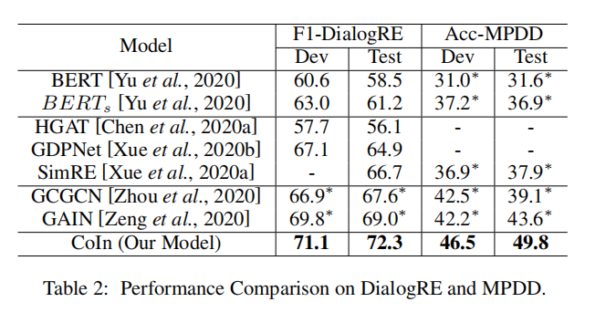
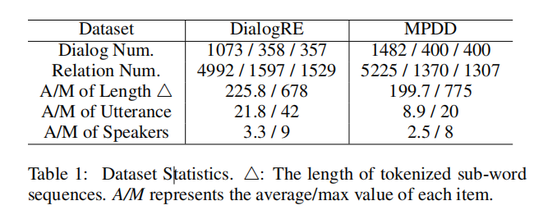
Experiments

Slide 9
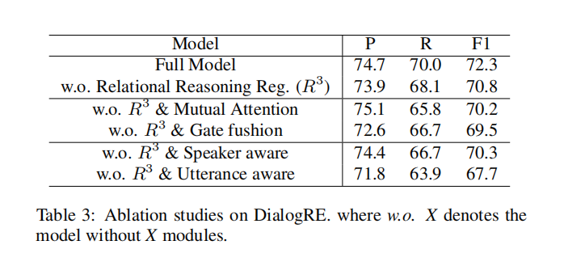
Experiments

Slide 10
Thanks

